Slide 1

Basics

Slide 2

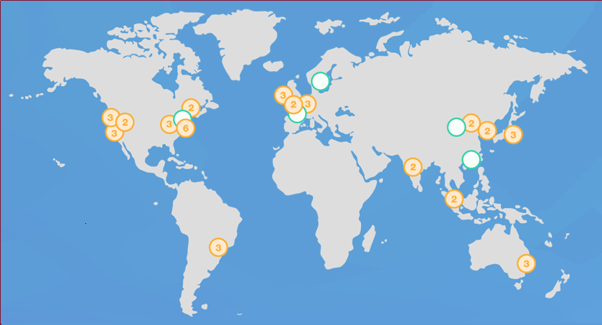
Regions and Zones
AWS now spans 77 Availability Zones within 24 geographic regions around the world

Slide 3

What is Regions?
Physical location around the world where we cluster data centers
Each AWS Region consists of multiple, isolated, and physically separate AZ's within a geographic area.
Each AZ has independent power, cooling, and physical security and is connected via redundant, ultra-low-latency networks
AWS infrastructure Regions meet the highest levels of security, compliance, and data protection.

Slide 4
What is Availability Zones?
An Availability Zone (AZ) is one or more discrete data centers with redundant power, networking, and connectivity in an AWS Region.
AZ’s give customers the ability to operate production applications and databases that are more highly available, fault tolerant, and scalable than would be possible from a single data center.
All AZ’s in an AWS Region are interconnected with high-bandwidth, low-latency networking, over fully redundant, dedicated metro fiber providing high-throughput, low-latency networking between AZ’s
AZ’s are physically separated by a meaningful distance, many kilometers, from any other AZ, although all are within 100 km (60 miles) of each other.

Slide 5


Slide 6
Availability Zones continue…
Availability Zone may be several data centers and but if they're really close together, they're going to be counted as one availability zone.
So, one availability zone could be two or three data centers that are all within say a couple of miles of each other that way if there is a flood it might take out all three facilities or it might take out that availability zone.
Then you'll have another availability zone that will be you know 100 miles away and if that if it floods in one area it's not going to affect the other area.

Slide 7


Slide 8
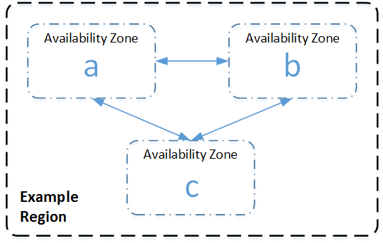

Slide 9
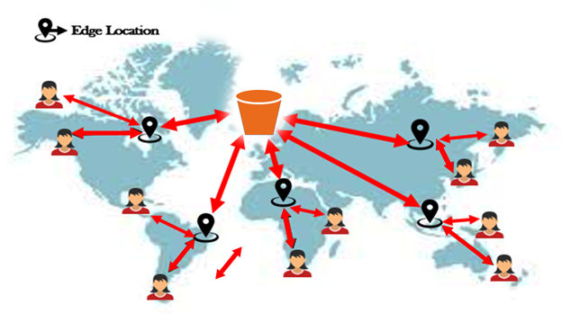
What is Edge Location?
Edge Location are endpoints for the aws which you use for caching content. Typically, this consists of cloud front, Amazon's content delivery network.
We're going to have a look at that in the S3 section

Slide 10
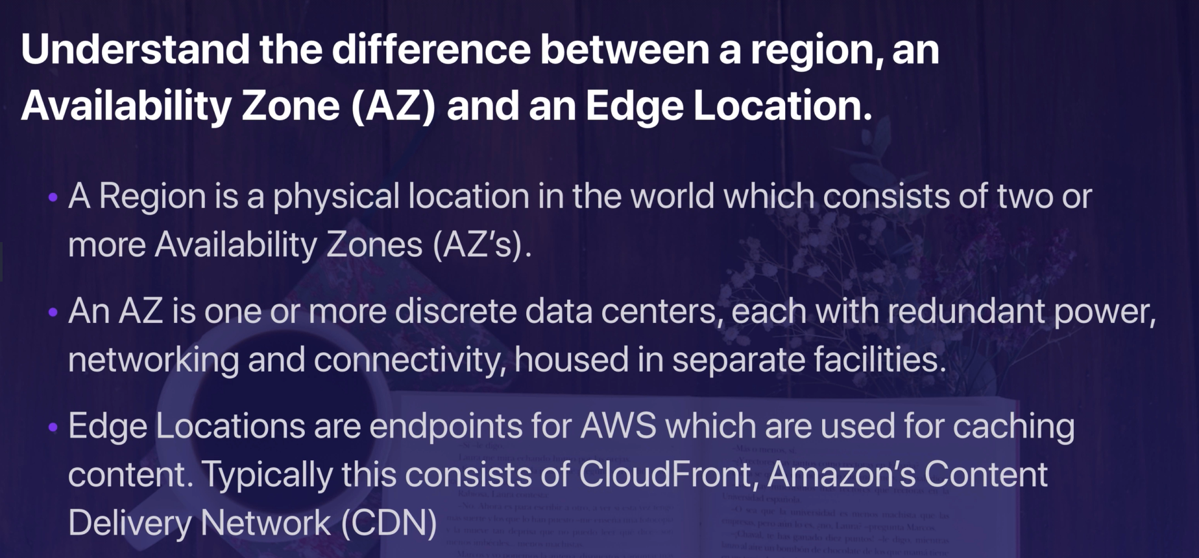

Slide 11
Thank you

